Slide 1
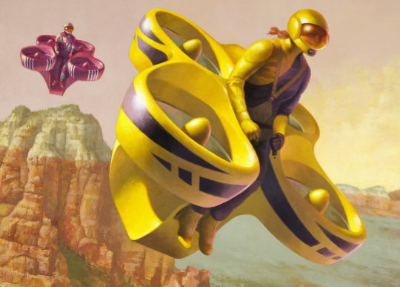
Midpoint Presentation
Figure 1-Novakinetics concept art [1]
By Steve Sorden, Travis Byakeddy, Corey Marcum, Nathaniel Schaul
Notes:
corey

Slide 2
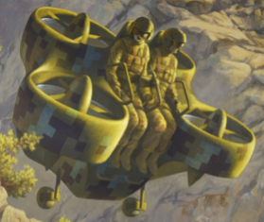
Topic 1: Project description
Design a frame for piloted quadcopter aircraft designed by Novakinetics using Finite Element Analysis ANSYS simulations and modeling. Analyze different materials and dimensions for use in the frame.
Notes:
corey

Slide 3
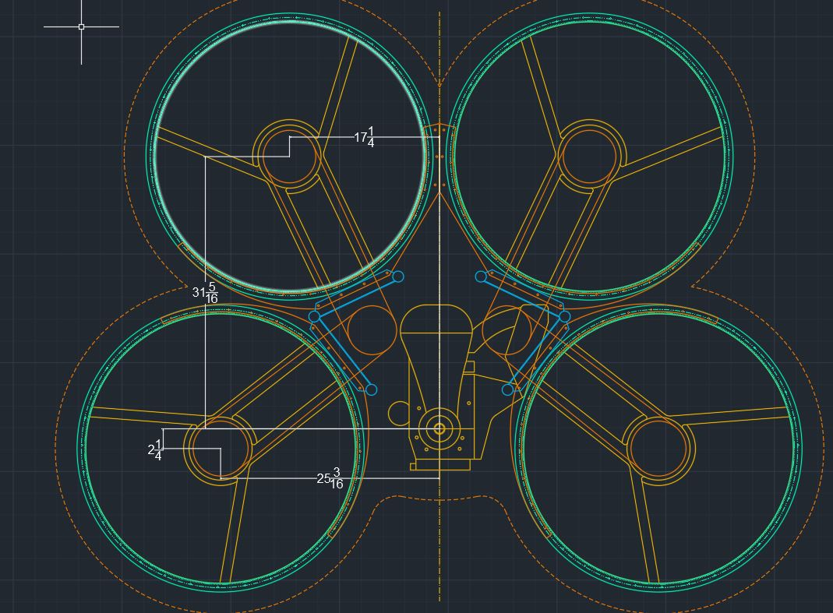
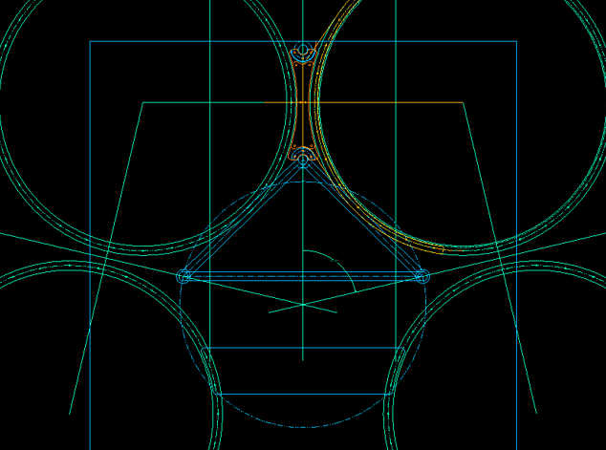
Topic 2: Design Description
Client Redesign Client Original Design
Notes:
corey

Slide 4
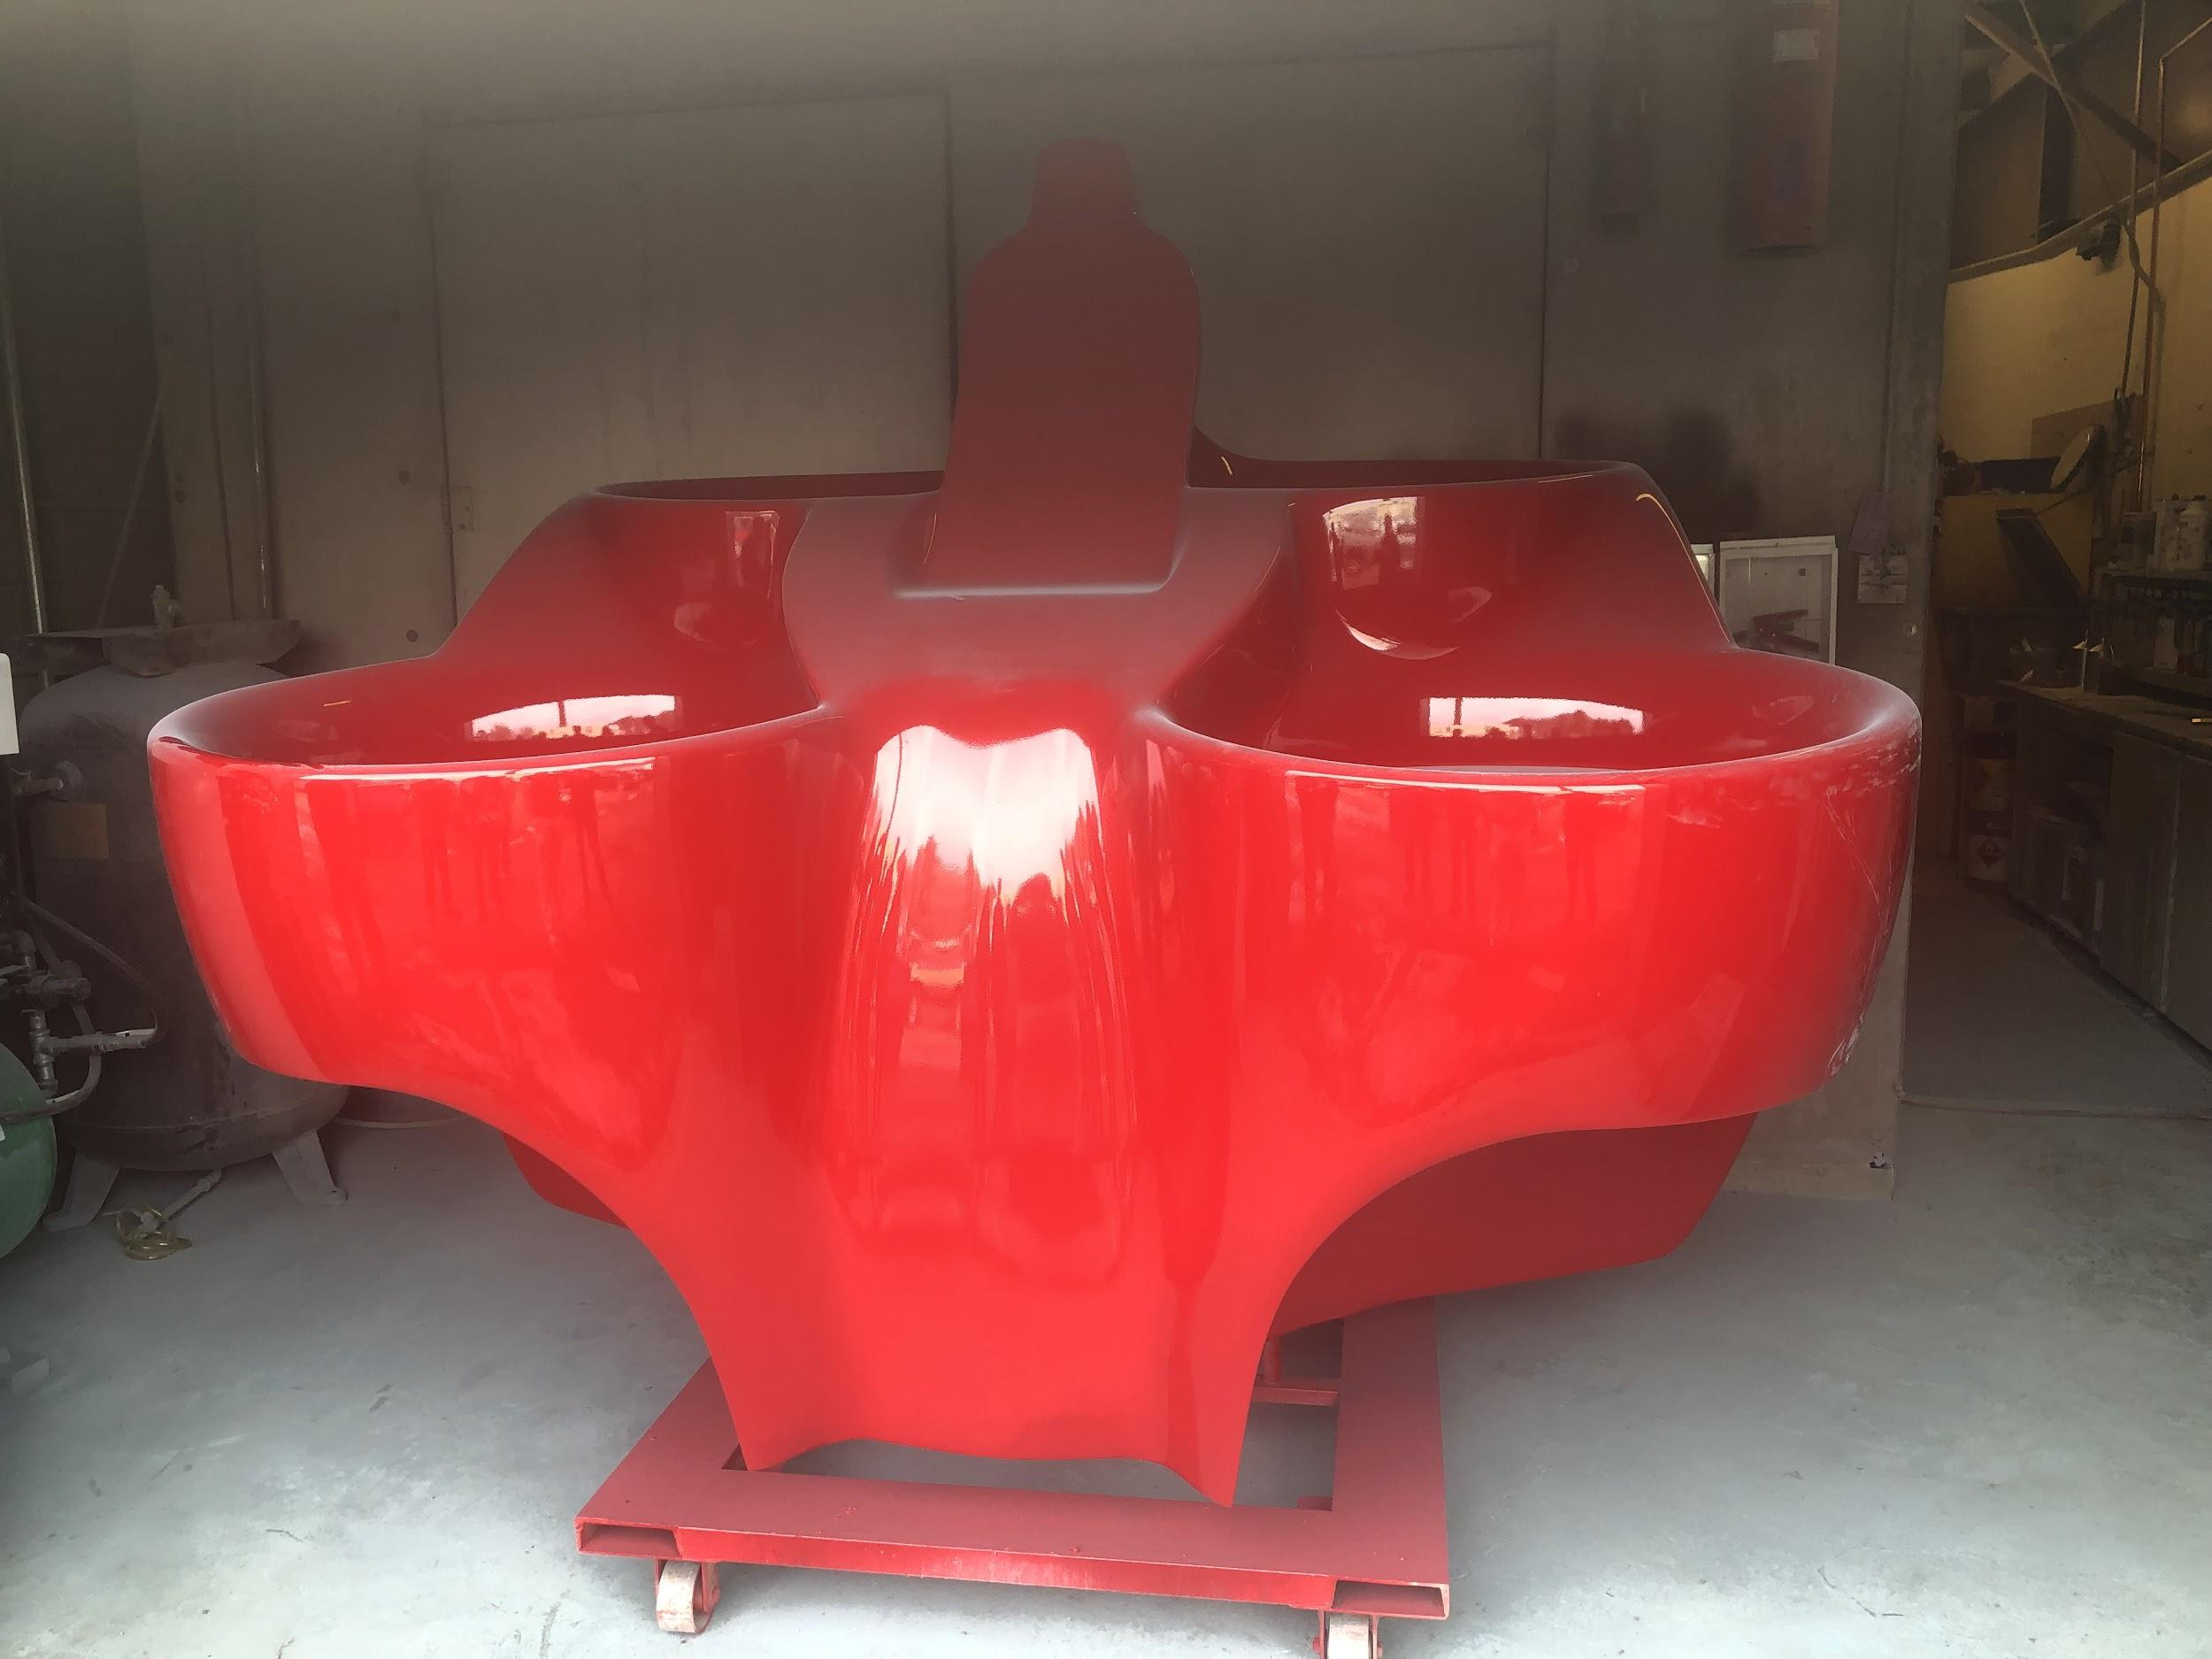
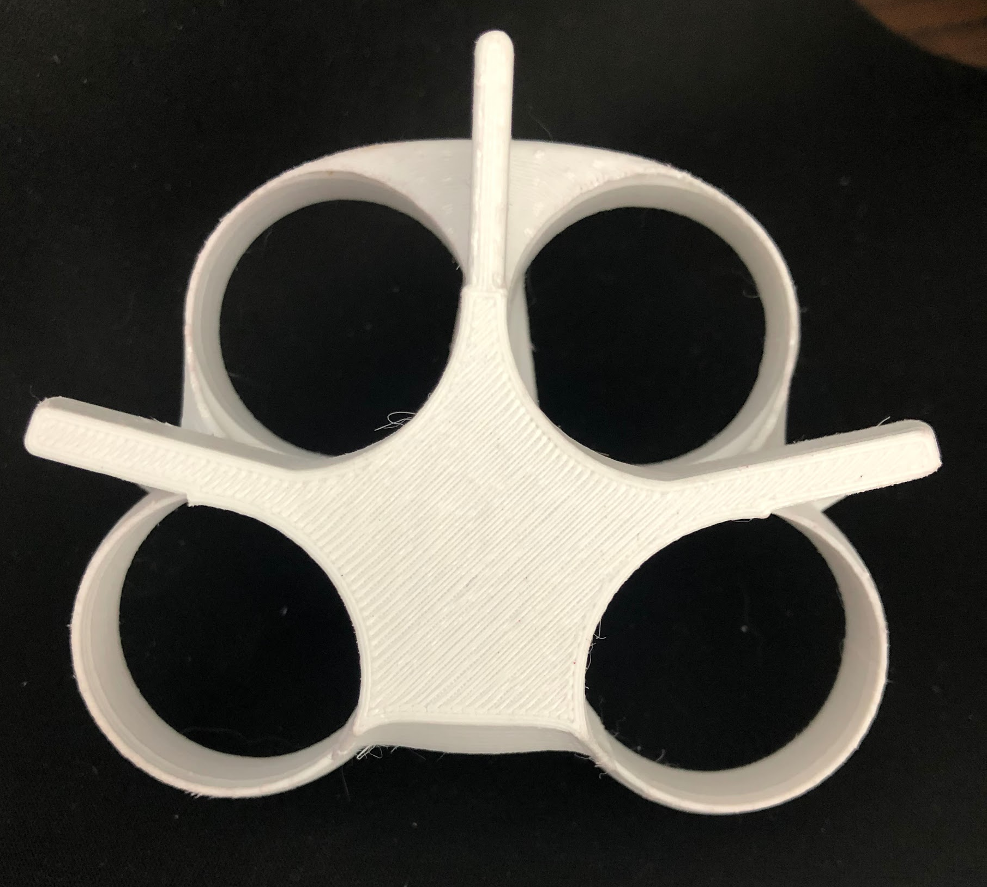
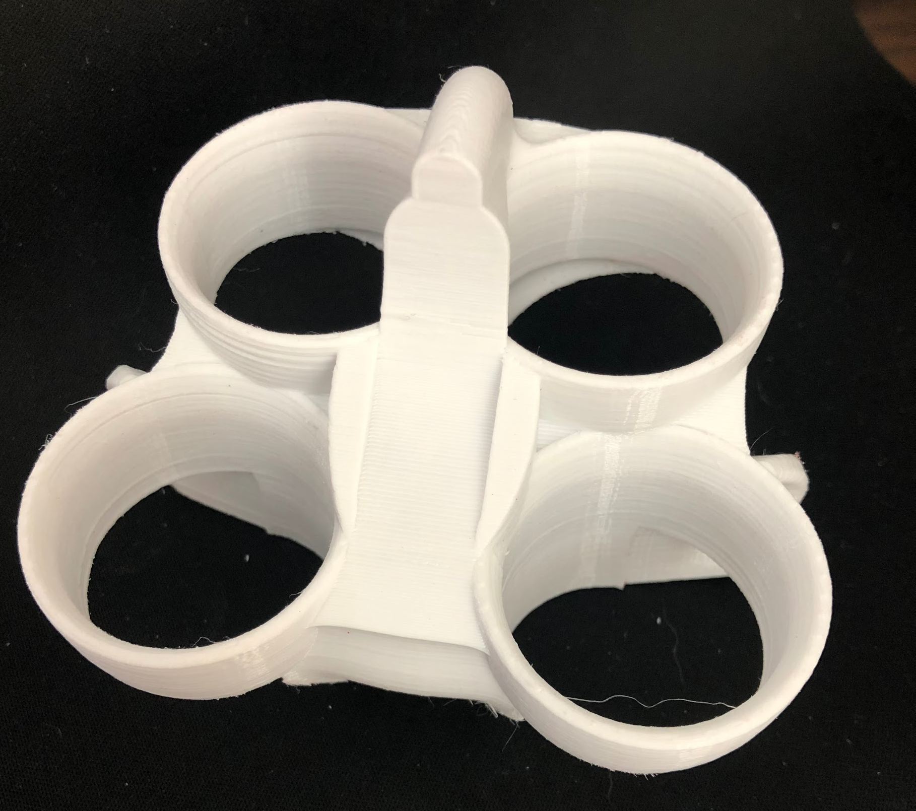
FanFlyer Shell Design
Back FanFlyer
Bottom FanFlyer
Left FanFlyer
Iso FanFlyer
Notes:
steve

Slide 5
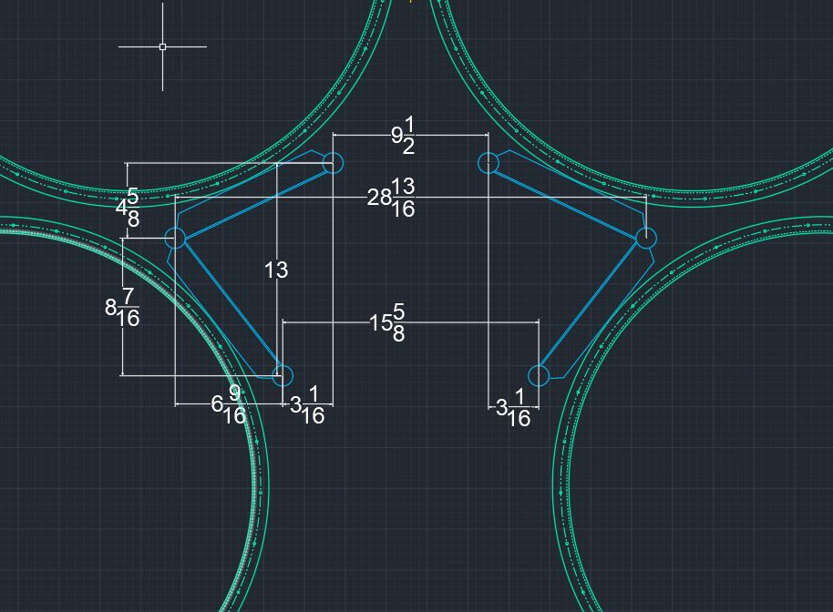
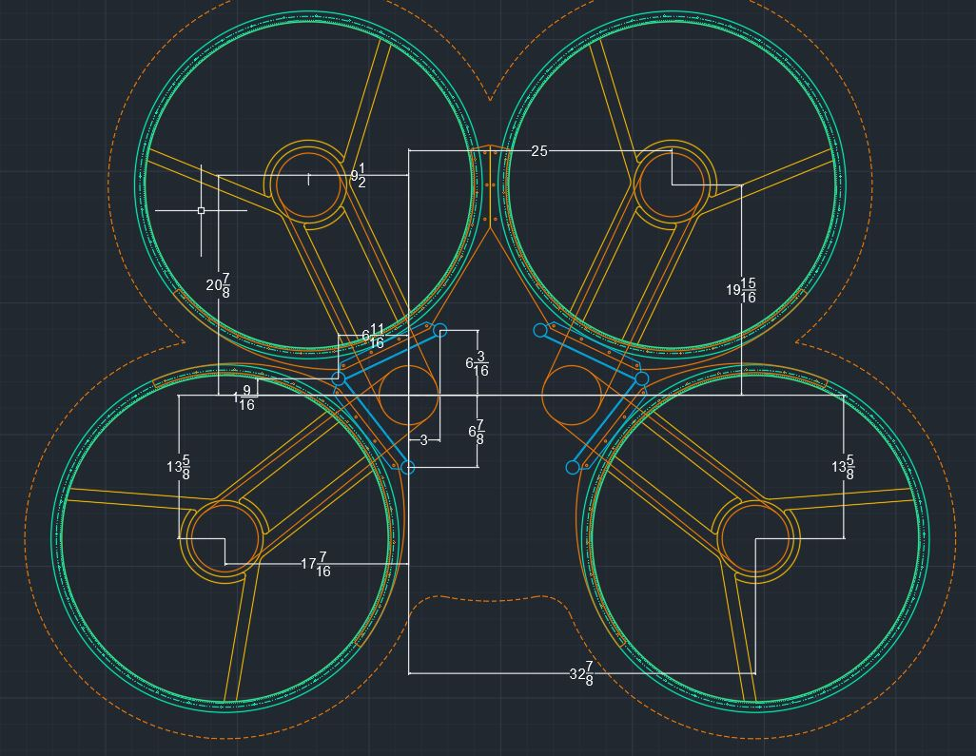
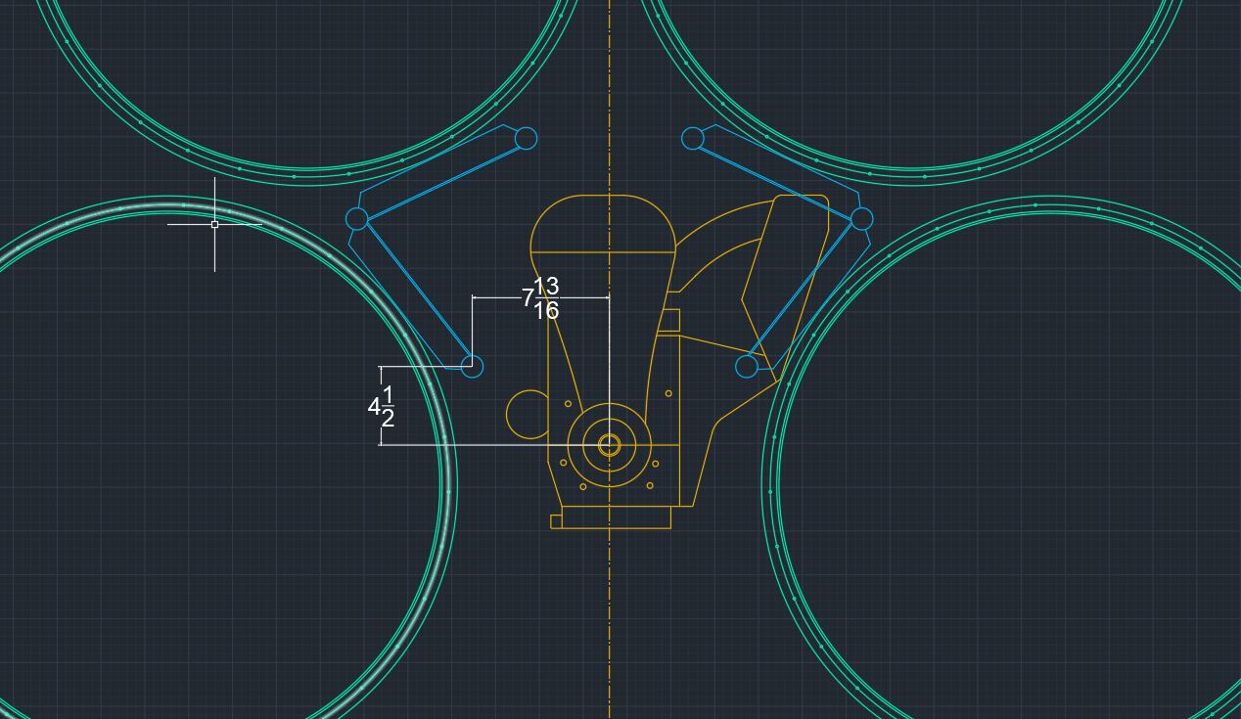
Design Specifications
Notes:
steve

Slide 6
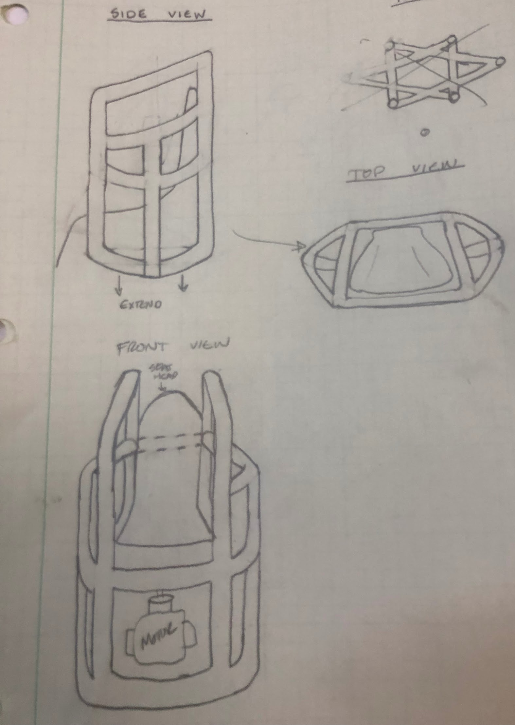
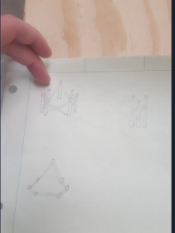
Topic 3: ER & Manufacturing thus far
Sketches

Slide 7
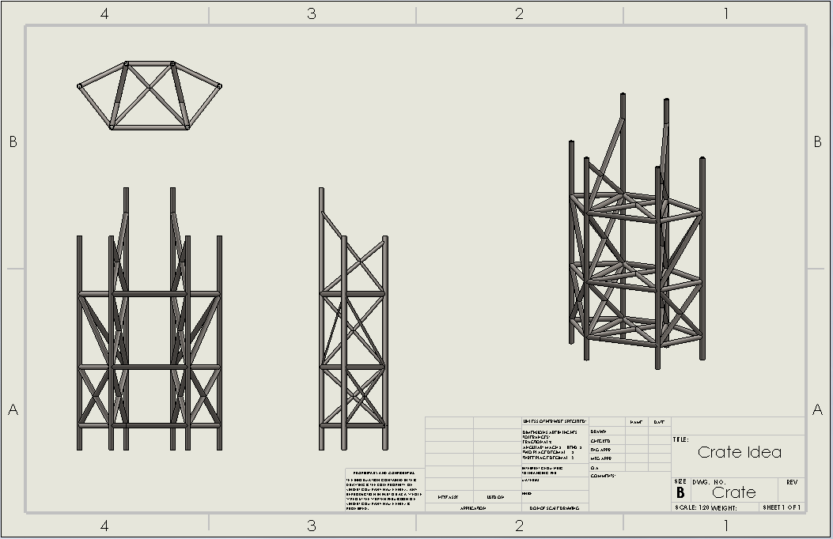
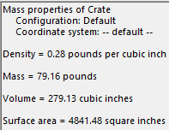
General Concepts

Slide 8
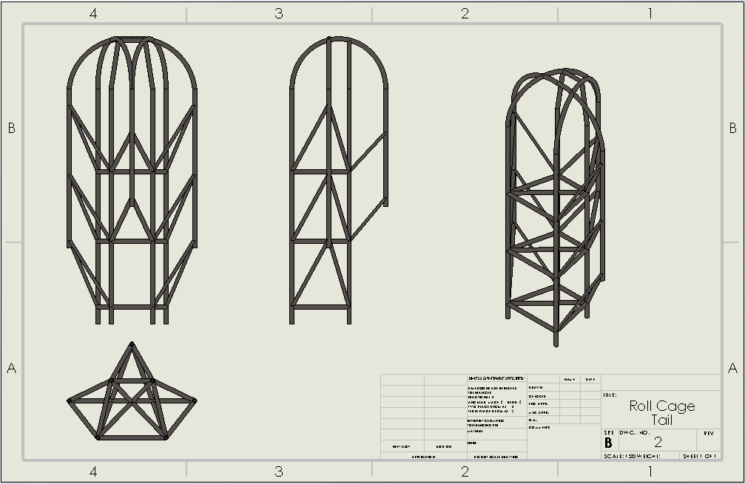
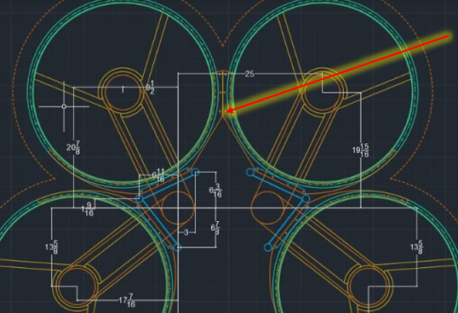
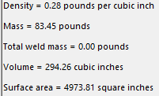
Upgraded Concept

Slide 9
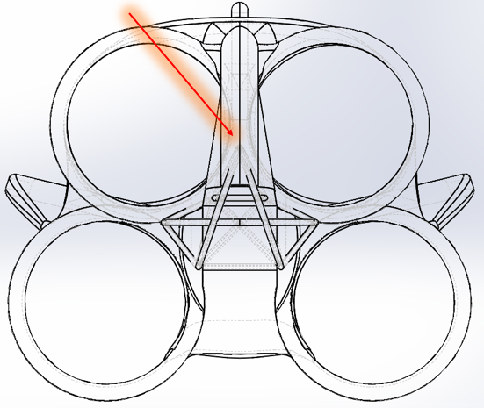
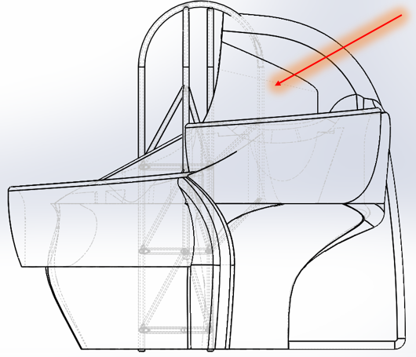
Location of 7th requested support
Top Side

Slide 10
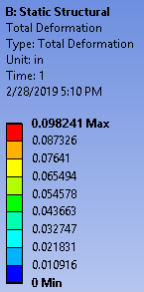
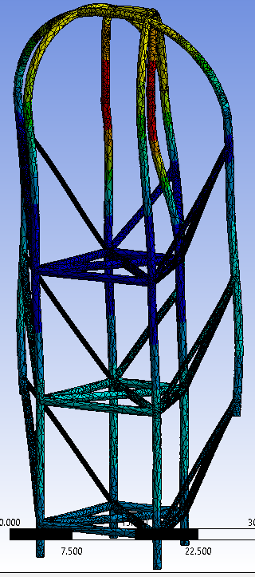
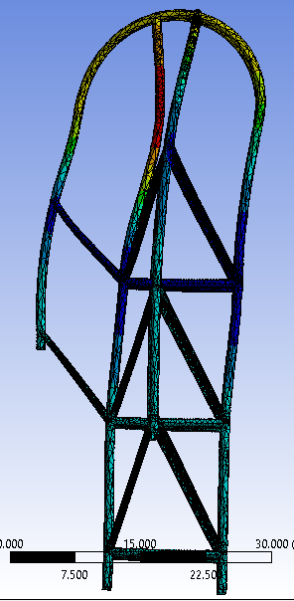
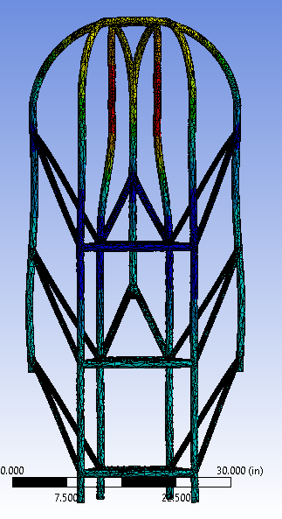
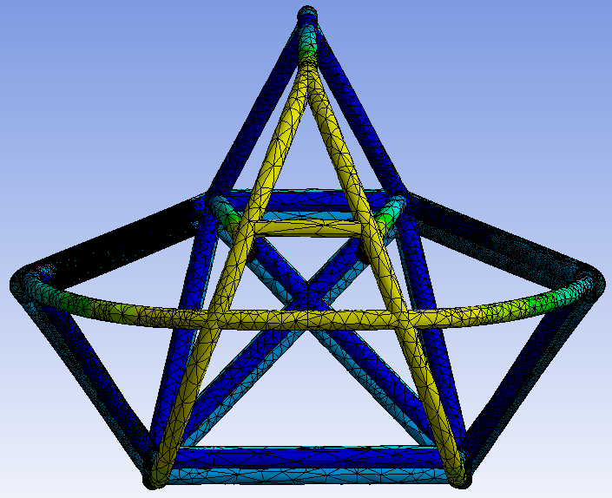
Center Fixed point - Deformation

Slide 11
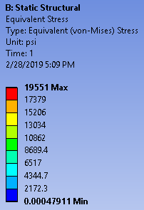
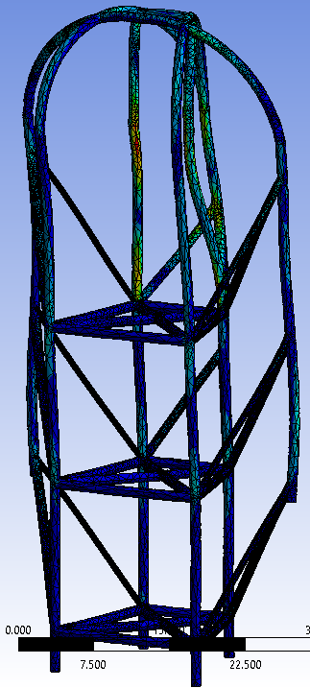
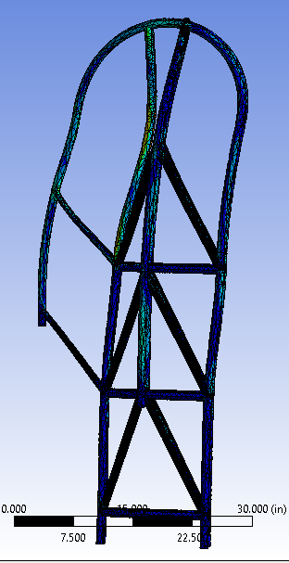
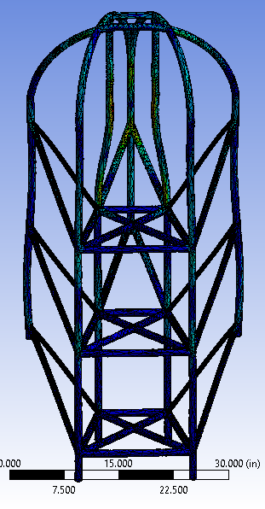
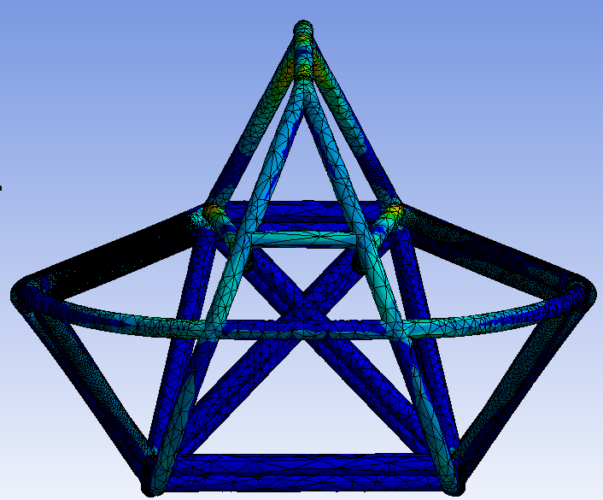
Fixed Center Point - Stress

Slide 12
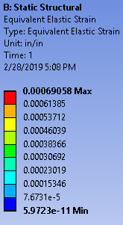
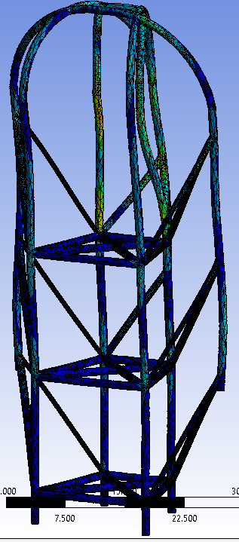
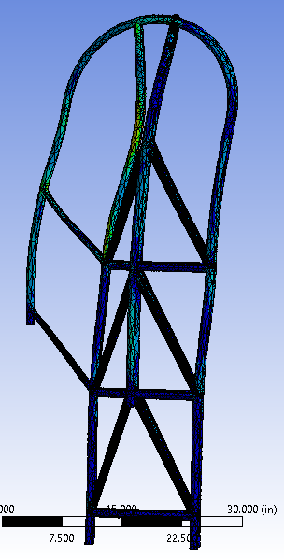
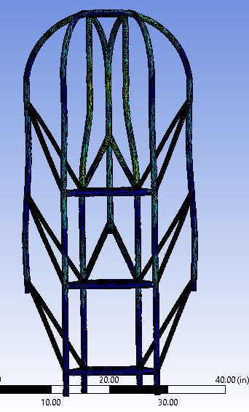
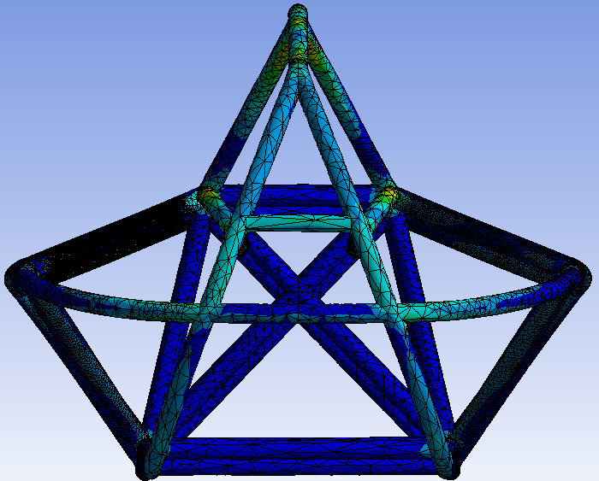
Fixed Center Point - Strain

Slide 13
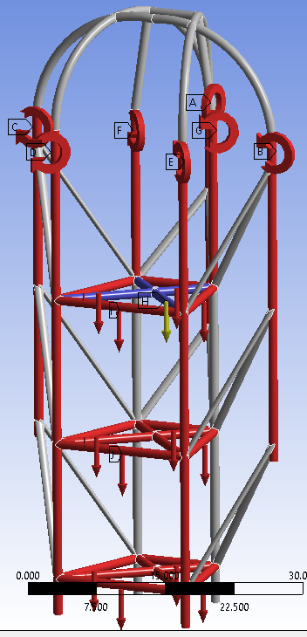
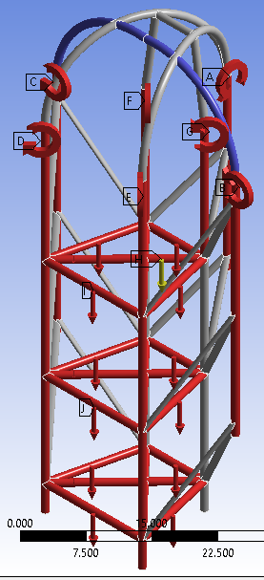
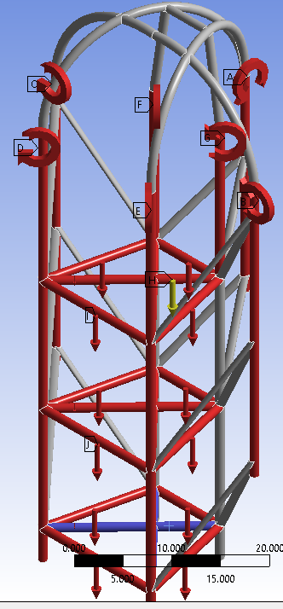
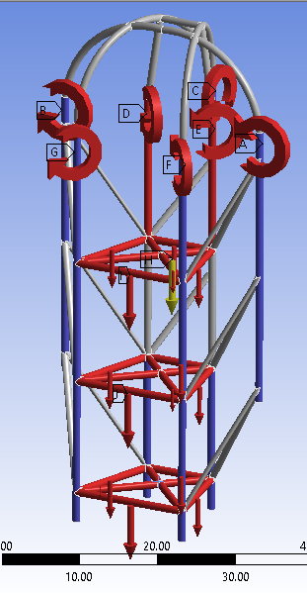
Various Fixed ANSYS points
Center Top Bottom All Vertical

Slide 14
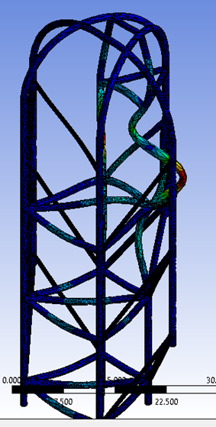
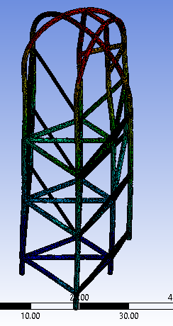
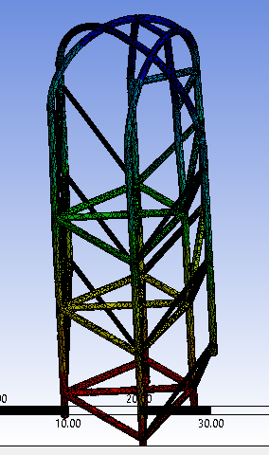
Redesign 2 - one vs multiple fixed points
Multiple Fixed Points
Bottom Fixed point Top Fixed point

Slide 15
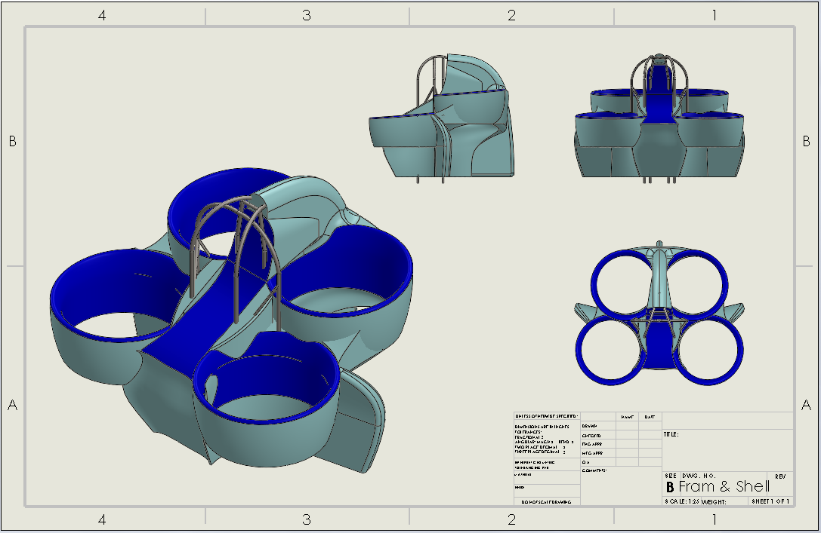
Frame and Shell

Slide 16
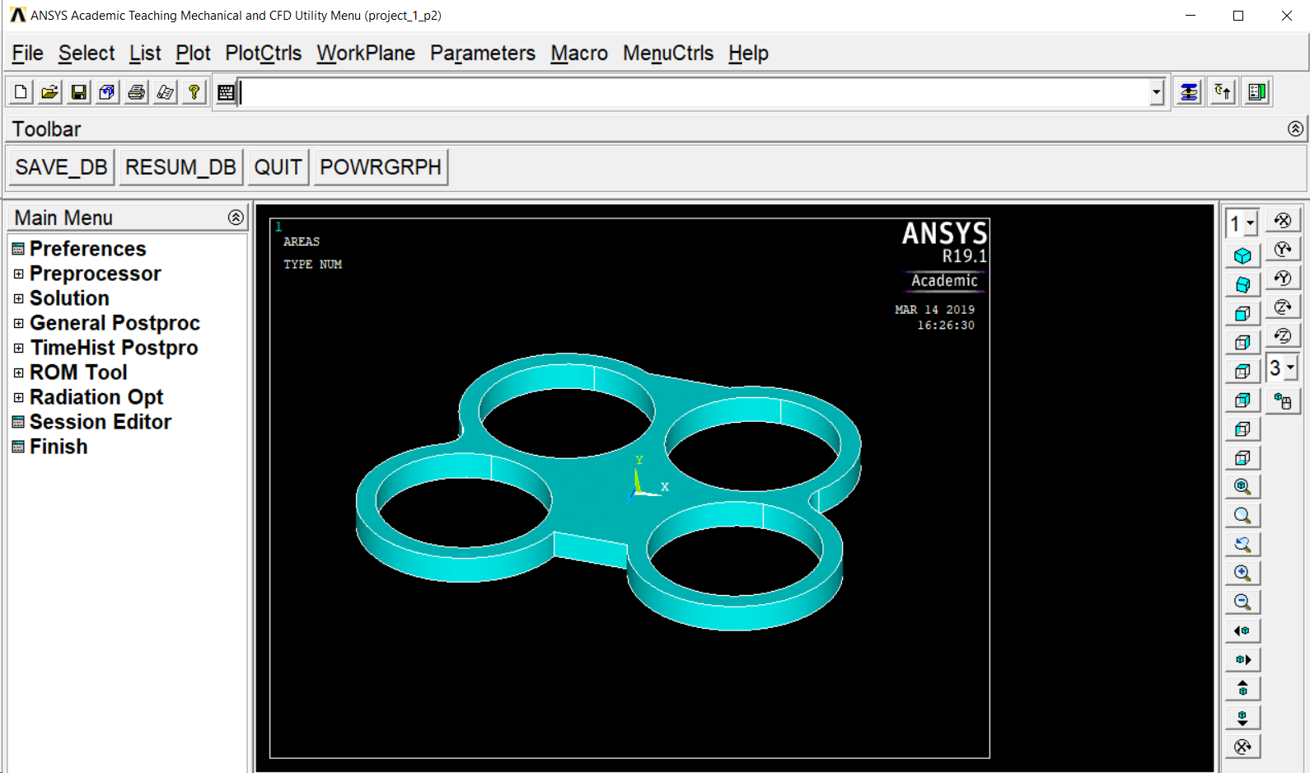
Recommendations
Met with Dr. Penado, ME454 professor
-Closed form solutions for calculations of G-Forces.
-Use ANSYS mechanical APDL 19.1 instead of ANSYS Workbench
ANSYS mechanical APDL 19.1

Slide 17
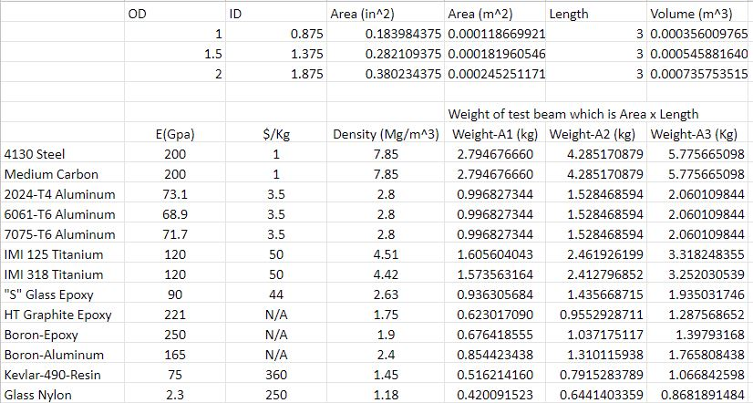
Materials List
Notes:
steve

Slide 18
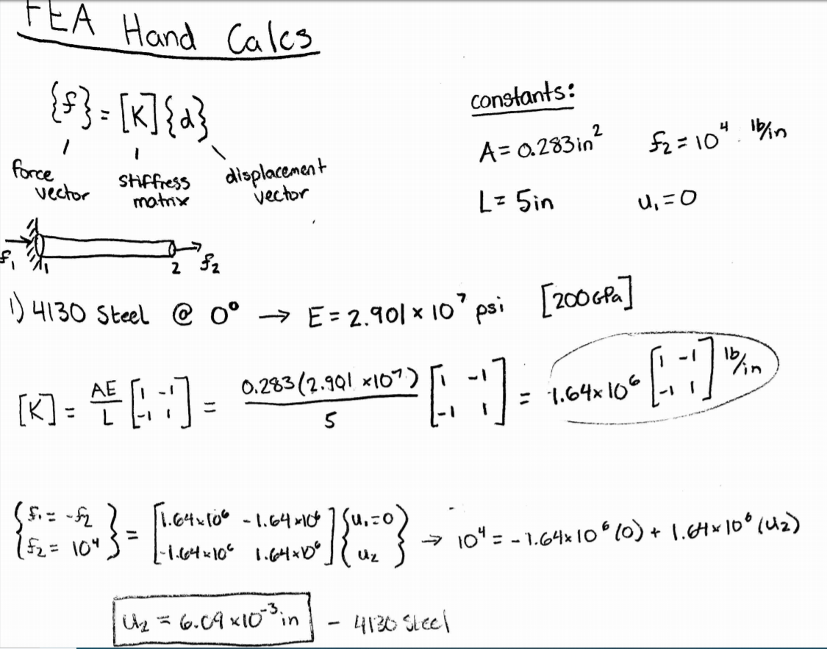
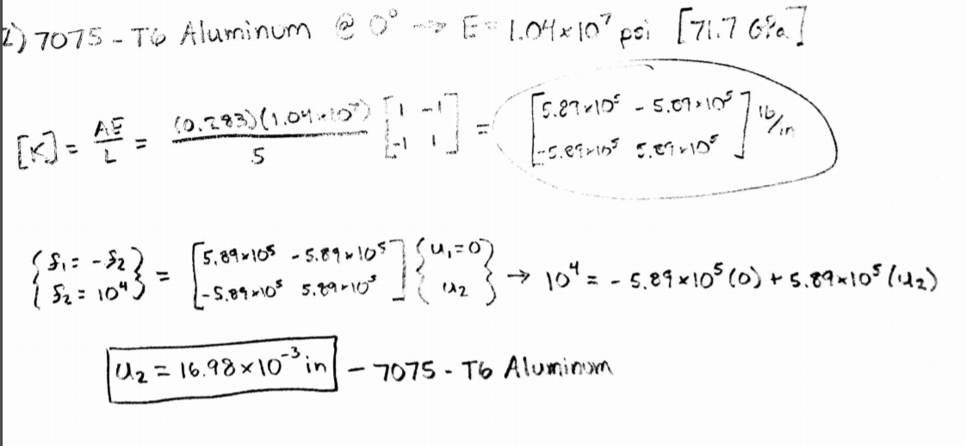
Simple FEA Deflection Hand Calculations
Deflection for 4130 Steel: 0.1547 mm
Deflection for 7075-T6 Aluminum: 0.4313 mm
Aluminum is 2.8 times larger
Notes:
corey

Slide 19
Materials Cont.
Notes:
steve

Slide 20
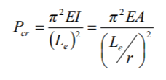
Euler’s Formula For Critical Loads [1]
Critical Load Formula
Critical Stress Formula
Notes:
corey

Slide 21
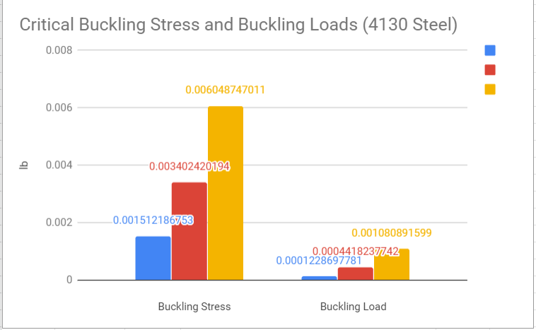
Material Testing [2]
Blue = 1 in OD, Red = 1.5 in OD, Yellow = 2 in OD
t (thickness) = 0.125 in, l (length) = 3 in
Clients choice (4130 Steel) vs Competitive choice (HT Graphite Epoxy)
Notes:
corey

Slide 22
Topic 4: Schedule & Budget
Budget
Client based
Schedule
Determine final design and present it to Jim Corning
On going hand calculations and ANSYS simulations for better designs

Slide 23
Moving Forward [2]
Travis: Perform more ANSYS simulations for each frame redesign. Continue with the proper 4130 steel properties addition to ANSYS. Continue with 3d printed force model of the Flyer, to help visualize contributions. Test ANSYS models under different approved materials. Continue with client solidworks redesigns.
Steve: Redesign frames with client and Ansys considerations, Model new frames within solidworks, assist Travis in ansys modeling of proposed frames, continue materials list and consider proposed materials to client based on research and FEA stress and deformation calculation, aid in hand calculations for FEA check, Print final proposed frame for client.
Corey: Continue hand calculations once a final frame has been designed, create working code program to test different materials under different boundary conditions, aid in designs for final proposed frame for the client, aid in ANSYS analysis of different frames.
Nathaniel: Choose a final design for our client with team.

Slide 24
References
[1] Rigid Frames - Compression and Buckling. Note Set 11.1. 2013. Available: http://faculty-legacy.arch.tamu.edu/anichols/index_files/courses/arch614/arch614old/NS11-1frames.pdf
[2] NAU FanFlyer Team. ‘Hardware Review 1,’ Flagstaff, 2019.

